Slide 1



UNIT 2: Home is where heart is
What makes my world

Slide 2
Things around us are made of different materials.
Can you name some materials?
TRANSLATE
wood – concrete –
plastic – leather –
brick –
cotton –
drvo
beton
plastika
koža
cigla
pamuk

Slide 3
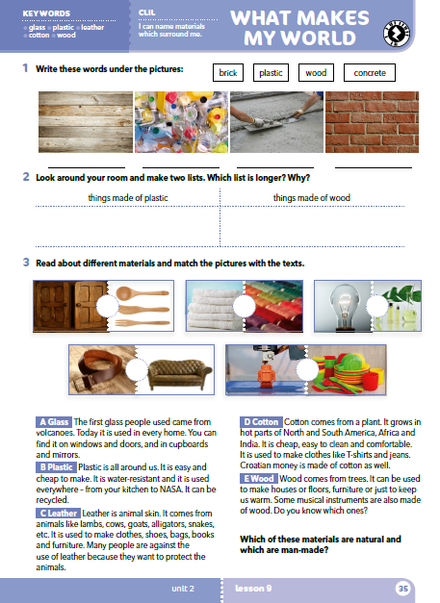
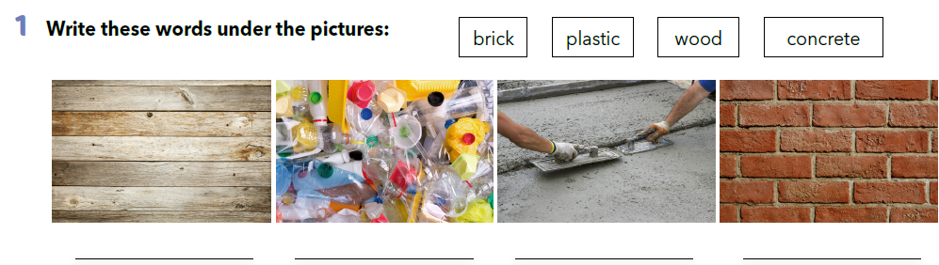
wood
plastic
concrete
brick

Slide 4
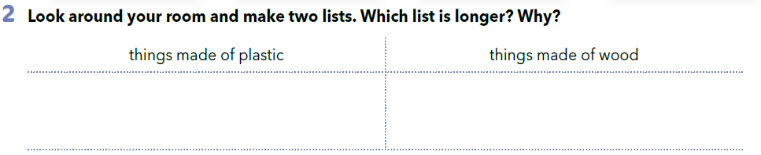

Slide 5
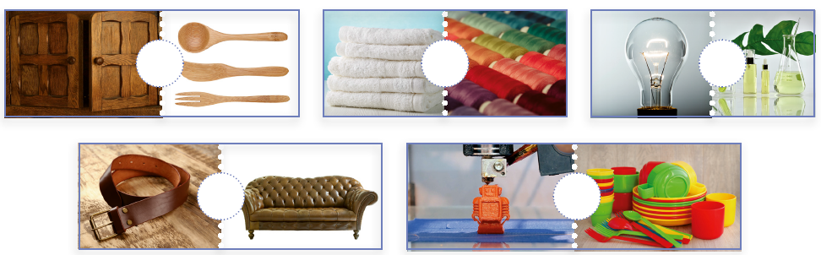
Which three materials are in the pictures, but we haven’t named them yet?
What can you see in the pictures?
Do you use any of these things?

Slide 6
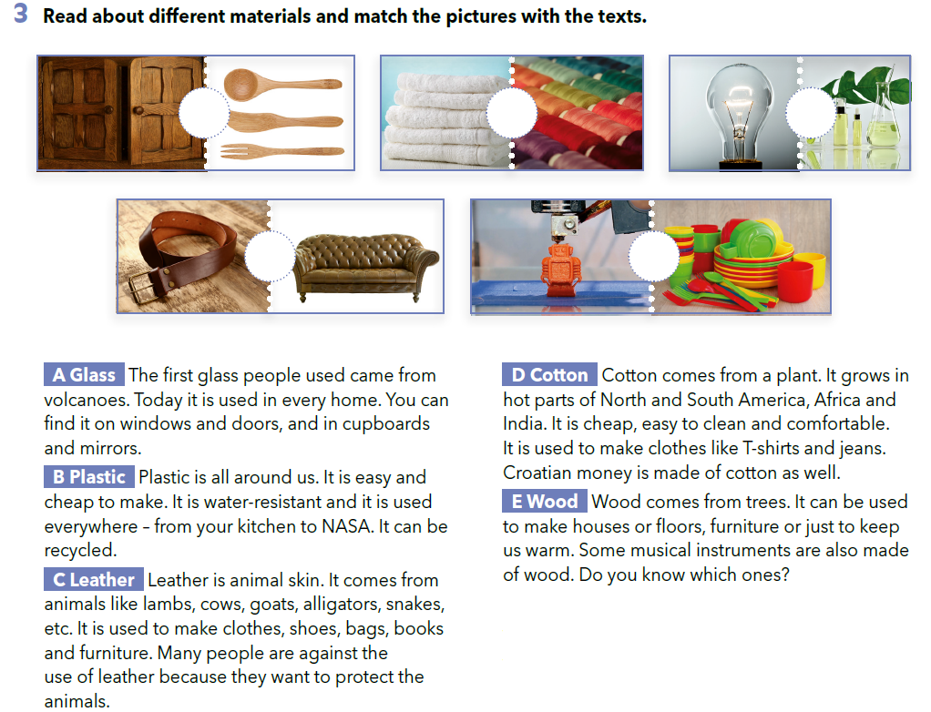
E
D
A
C
B

Slide 7
Which of these materials are natural and which are man-made?
Natural materials are wood, cotton and leather.
Man-made materials are glass and plastic.

Slide 8
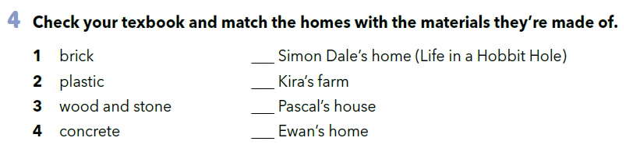
Look at the houses in Unit 2?
Which materials are their houses made of?
3
1
2
4

Slide 9
LET’S REVISE!
Check your knowledge about materials.
https://learningapps.org/view5227123

Slide 10
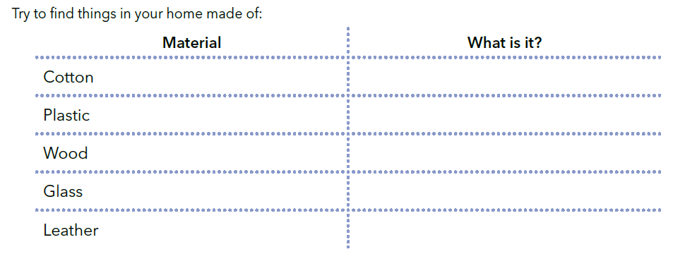
PROJECT TIME!

Slide 11

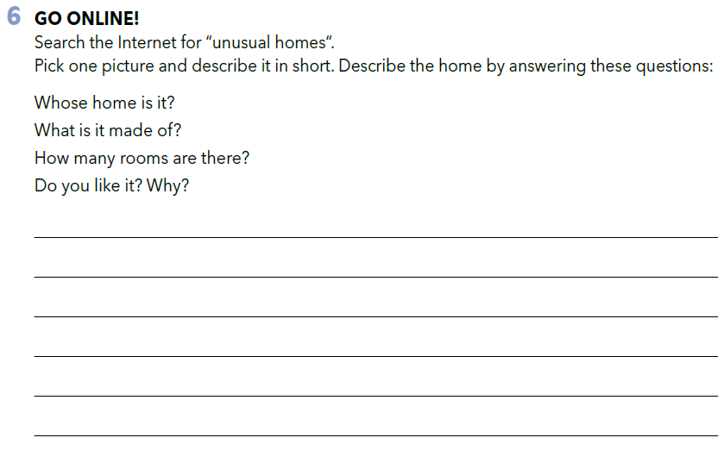
PROJECT TIME!

Slide 12

LEARN MORE.
https://www.e-sfera.hr/dodatni-digitalni-sadrzaji/bf473c20-a04f-4cfc-a824-2123d2f8efe6/
Materials
Look at the information about different materials. Use the guidelines and write the text.

